Slide 1
Download slides from the following URL
https://github.com/HybridGraph/software-testing
Software Testing
Chapter 3 White-Box Testing

Slide 2

Contents
White-Box Testing
3.1 Basic Concepts
3.2 Logic Coverage
3.3 Control Flow Graph
3.4 Basis Path Testing
3.5 Loop Testing
3.6 Data Flow Testing
3.7 A Comparison of White-box Testing and Black-box Testing
Chapter 3

Slide 3
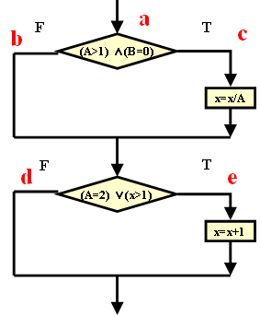
Review-1
Logic Coverage
  Statement coverage
  Decision coverage
  Condition coverage
  Condition/decision coverage
  Condition combination coverage
  Path coverage
Notes:
路径测试就是从一个程序的入口开始，执行所经历的各个语句的完整过程。从广义的角度讲，任何有关路径分析的测试都可以被称为路径测试。
完成路径测试的理想情况是做到路径覆盖，但对于复杂性大的程序要做到所有路径覆盖是不可能的。
在不能做到所有路径覆盖的前提下，如果某一程序的每一个独立路径都被测试过，那么可以认为程序中的每个语句都已经检验过了，即达到了语句覆盖。这种测试方法就是通常所说的基本路径测试法。

Slide 4
Condition coverage: OK; Decision coverage: OK
Condition coverage: OK; Decision coverage: No
Test case | Path | Condition value | Coverage branch
(2, 0, 3) | ace(L1) | T1 T2 T3 T4 | c，e
(1, 1, 1) | abd(L2) | !T1 !T2 !T3 !T4 | b，d
Test case | Path | Condition value | Coverage branch
(1, 0, 3) | abe(L3) | !T1 T2 !T3 T4 | b，e
(2, 1, 1) | abe(L3) | T1 !T2 T3 !T4 | b，e
Notes:
203和111，覆盖了4个条件的8种情况，同时，4个分支也覆盖。
问题是，做到条件覆盖，一定可以判定覆盖？
103，211这2个满足条件覆盖，但无法判定覆盖

Slide 5
① A＞1, B＝0 as T1T2
② A＞1, B≠0 as T1!T2
③ A≯1, B＝0 as !T1T2
④ A≯1, B≠0 as !T1!T2
⑤ A＝2, X＞1 as T3T4
⑥ A＝2, X≯1 as T3!T4
⑦ A≠2, X＞1 as !T3T4
⑧ A≠2, X≯1 as !T3!T4

Slide 6
Complete coverage
No. | Test case | path | Condition combination coverage
1 | (2, 0, 3) | ace(L1) | ① ⑤
2 | (1, 0, 1) | abd(L2) | ④ ⑧
3 | (2, 1, 1) | abe(L3) | ② ⑥
4 | (3, 0, 3) | acd(L4) | ① ⑧
5 | (1, 0, 3) | abe(L3) | ③ ⑦

Slide 7
Review-2
Relationships
path
condition combination
decision—condition
decision
condition
statement

Slide 8
3.3 Introduction
Path analysis: paths from the entry of the program to the exit of the program; these paths can cover all statements.
Testing based on path analysis is called Path Testing
  The ideal scenario: path coverage
    That might be impossible when there are many condition statements.
  Independent path: a path including at least one new condition or new executable statement
A
B
C
D
E
F
G
Notes:
路径测试就是从一个程序的入口开始，执行所经历的各个语句的完整过程。从广义的角度讲，任何有关路径分析的测试都可以被称为路径测试。
完成路径测试的理想情况是做到路径覆盖，但对于复杂性大的程序要做到所有路径覆盖是不可能的。
在不能做到所有路径覆盖的前提下，如果某一程序的每一个独立路径都被测试过，那么可以认为程序中的每个语句都已经检验过了，即达到了语句覆盖。这种测试方法就是通常所说的基本路径测试法。

Slide 9
3.3 Introduction
Assuming that we cannot test all paths, if every independent path can be tested, then every executable statement will be tested (statement coverage)—basis path testing
Basis path testing is done based on control flow graph.
Notes:
路径测试就是从一个程序的入口开始，执行所经历的各个语句的完整过程。从广义的角度讲，任何有关路径分析的测试都可以被称为路径测试。
完成路径测试的理想情况是做到路径覆盖，但对于复杂性大的程序要做到所有路径覆盖是不可能的。
在不能做到所有路径覆盖的前提下，如果某一程序的每一个独立路径都被测试过，那么可以认为程序中的每个语句都已经检验过了，即达到了语句覆盖。这种测试方法就是通常所说的基本路径测试法。

Slide 10
3.3 Control Flow Graph
Concept
  Program flowchart is a directed graph which uses different symbols to indicate different processing operations or conditions. However, many of such symbols are not important when analyzing paths. During procedure design, in order to clearly show the control flow structure, the program flowchart can be simplified---the simplified graph is called control flow graph.
Notes:
程序流程图用来描述程序的结构性，是一个有向图，又叫框图，它采用不同的图形符号标明条件或者处理等。
由于这些符号在路径分析是不重要，为了突出控制流结构，我们将程序流程图简化，产生控制流图。

Slide 11
3.3 Control Flow Graph
There are two kinds of elements in a control flow graph:
  Node is a numbered circle which can represent one or more statements (a series of rectangles), a condition, and the joint point of multiple branches
    A predicated node is a node containing a condition.
    A complex condition should be decomposed into some basic conditions (e.g. A>0 and B<0 => if A>0 then if B<0 then…)
  Edges are arrows with labels which represent the flow of control
    Edges starting from a predicated node must stop at a joint node.
    Areas bounded by edges and nodes are called regions.
Notes:
程序流程图用来描述程序的结构性，是一个有向图，又叫框图，它采用不同的图形符号标明条件或者处理等。
由于这些符号在路径分析是不重要，为了突出控制流结构，我们将程序流程图简化，产生控制流图。

Slide 12
3.3 Control Flow Graph
Common control flow graph
Order statement
While statement
Until statement
IF statement
Case statement
Notes:
顺序结构 循环结构，选择结构，多分支结构

Slide 13
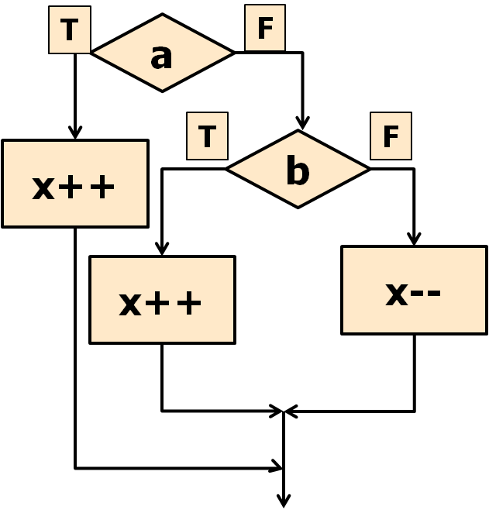
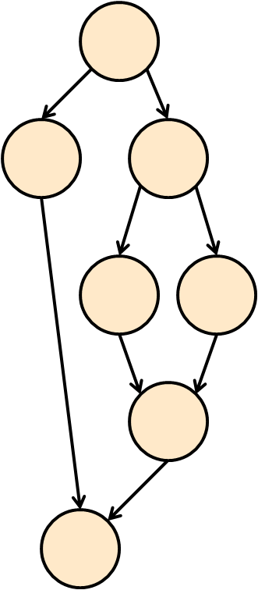
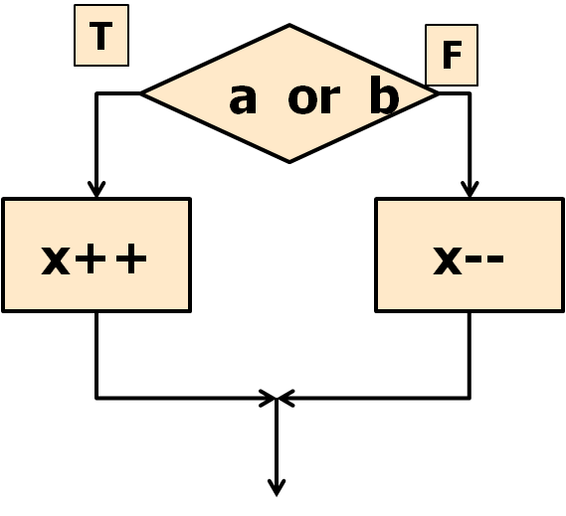
3.3 Control Flow Graph
Condition decomposition
Notes:
程序流程图用来描述程序的结构性，是一个有向图，又叫框图，它采用不同的图形符号标明条件或者处理等。
由于这些符号在路径分析是不重要，为了突出控制流结构，我们将程序流程图简化，产生控制流图。

Slide 14
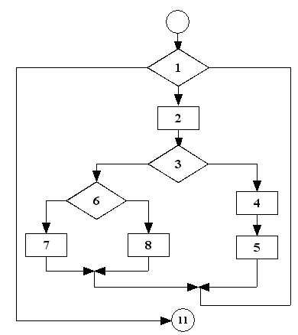
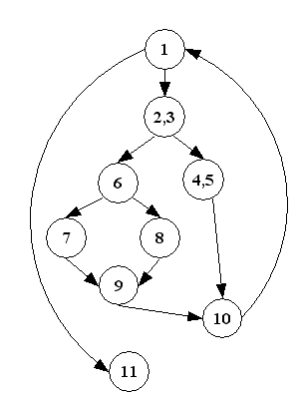
3.3 Control Flow Graph
Transform a program flowchart into a control flow graph
（a）program flow chart
（b）control flow graph
Notes:
在控制流图中只有两种图形符号，它们是： 节点：以标有编号的圆圈表示。 控制流线或弧：以箭头表示。
节点 1、标有编号的圆圈 2、程序流程图中矩形框['rektæŋg(ə)l]所表示的处理 3、菱形['rɒmbəs] 表示的两个甚至多个出口判断 4、多条流线相交的汇合点joint [dʒɒɪnt]
控制流线或弧 1、箭头 2、与程序流程图中的流线一致，表 明了控制的顺序
3、控制流线通常标有名字
在选择或多分支结构中，分支的汇聚处应有一个汇聚节点。
边和结点圈定的区域叫做区域，当对区域计数时，图形外的区域也应记为一个区域。

Slide 15
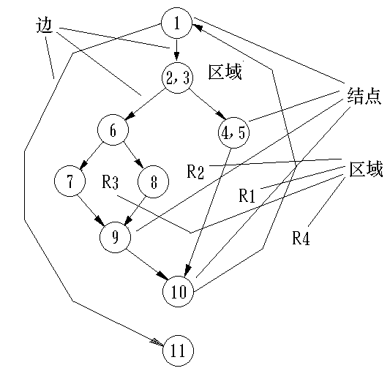
Edges
Regions
Nodes
Regions

Slide 16
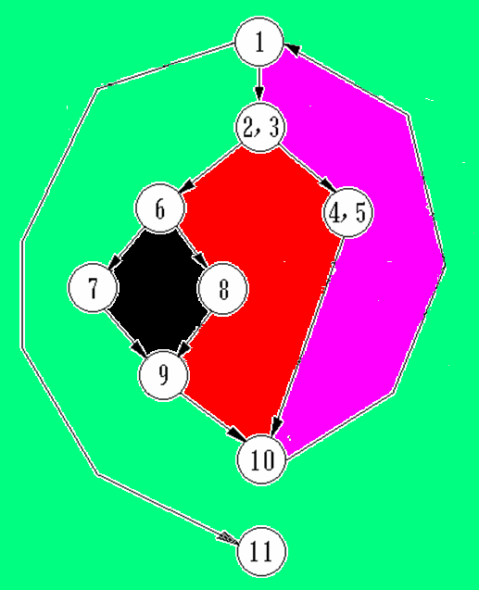
Four Regions
R2
R3
R1
R4

Slide 17
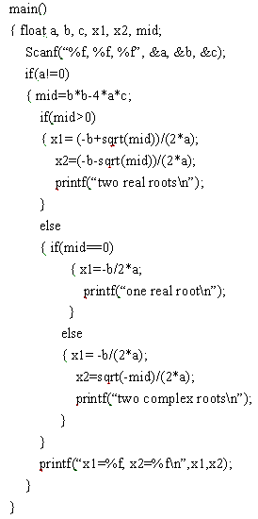
Exercise
1
9
1
2
2
8
3
3
4
5
6
4
7
7
5
8
6
9
Notes:
可能会有不同的画法，比如7、8被省略了，无所谓，不会影响最终的复杂度计数。

Slide 18
Exercise
Both are right
1
1
2
2
3
4
3
4
5
6
5
6
7
8
9
9
Notes:
可能会有不同的画法，比如7、8被省略了，无所谓，不会影响最终的复杂度计数。

Slide 19
3.4 Basis Path Testing
Four steps:
  1) draw the control flow graph
  2) calculate Cyclomatic Complexity so that we can infer how many independent paths there are, which is also the upper bound of test cases that make every executable statement implement at least once.
  3) get basis path set and then identify independent paths
  4) design test cases based on independent paths (input and expected output)
Notes:
在不能做到所有路径覆盖的前提下，如果某一程序的每一个独立路径都被测试过，那么可以认为程序中的每个语句都已经检验过了，即达到了语句覆盖。这种测试方法就是通常所说的基本路径测试法。
目的是得出一个合乎逻辑的复杂性措施的程序设计和使用为指导，定义了一套基本执行路径。

Slide 20
3.4 Basis Path Testing
Cyclomatic Complexity
  It gives a quantitative measure of the logical complexity.
  This value gives the number of independent paths in the basis set, and an upper bound for the number of tests to ensure that each statement and both sides of every condition is executed at least once.
Notes:
saicloumatik
环路复杂性即McCabe复杂性度量，在进行程序的基本路径测试时，从程序的环路复杂性可导出程序基本路径集合中的独立路径条数。
程序的环路复杂性给出了程序基本路径集中的独立路径条数，这是确保程序中每个可执行语句至少执行一次所必需的测试用例数目的上界。
独立路径：指包括一组以前没有处理的语句或条件的一条路径。
从控制流图来看，一条独立路径是至少包含有一条在其它独立路径中从未有过的边的路径。
一条路径这里指一条“程序通路”

Slide 21
3.4 Basis Path Testing
Cyclomatic Complexity =
  #Edges - #Nodes + #terminal vertices (usually 2)
  #Predicated Nodes + 1
  Number of regions of flow graph.
Notes:
判定节点的数量+1；
流图中区域的数量；
在计算机图论中,强连通（Strongly Connected）是指有向图G（Directed Graph）中任意两点v1、v2之间都存在着v1到v2的路径(path,若途径的点和边都不重复,则称为路径)及v2到v1的路径。E-N+p
给定流图G的环形复杂度V(G),定义为V(G)=E-N+2, E是流图中边的数量，N是流图中节点的数量。E-N+2p

Slide 22
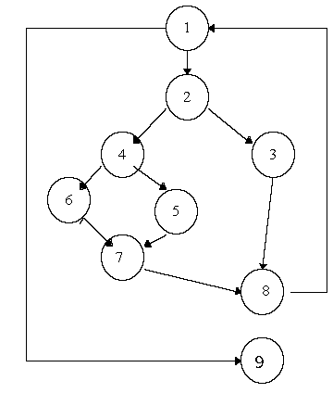
3.4 Basis Path Testing
4 Independent Paths:
  1, 9
  1, 2, 3, 8, 1, 9
  1, 2, 4, 5, 7, 8, 1, 9
  1, 2, 4, 6, 7, 8, 1, 9
Notes:
独立路径

Slide 23
3.4 Basis Path Testing
Deriving Test Cases
  Using the design or code, draw the corresponding flow graph.
  Determine the cyclomatic complexity of the flow graph.
  Determine a basis set of independent paths.
  Prepare test cases that will force execution of each path in the basis set.
Notes:
基本路径测试法的步骤：
(1)以详细或源代码作为基础，导出程序的控制流图。
(2)计算得到控制流图G的环路复杂度V(G)
(3)确定基本路径集，生成测试用例，确保基本路径集中每条路径的执行。
导出测试用例，确保基本路径集中的每一条路径的执行。
根据判断结点给出的条件，选择适当的数据以保证某一条路径可以被测试到 — 用逻辑覆盖方法。

Slide 24
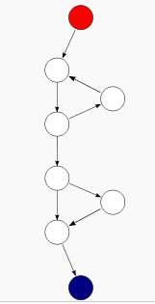
3.4 Basis Path Testing
Cyclomatic Complexity=3
Notes:
9-8+2；2+1；

Slide 25
3.4 Basis Path Testing
1. main()
2. {
int i, n, f;
printf(“n = ”);
Scanf(“%d”, &n);
If (n<0) {
pirntf(“Invalid: %d\n” , n);
n = -1;
} else {
f = 1;
for (i = 1; i <=n; i++) {
f*=i;
}
Printf(“%d! = %d.\n”, n, f);
}
Return n;
17. }
Enter
T
n<0
F
i<=n
F
T
Exit

Slide 26
3.4 Basis Path Testing
Cyclomatic complexity
  2+1=3
  1 -> 2 -> 4
  1 -> 2 -> 3 -> 4
  1 -> 2 -> 3 -> 3 -> 4
Enter
1
T
n<0
F
2
i<=n
3
F
T
Exit
4

Slide 27
3.4 Basis Path Testing
Path | Input | Expected result
1 -> 2 -> 4 | -1 | Invalid :-1
1 -> 2 -> 3 -> 4 | 0 | 0!=1
1 -> 2 -> 3 -> 3 -> 4 | 1 | 1!=1

Slide 28
3.4 Basis Path Testing
Start
A
Exercise:
  Cyclomatic complexity?
  Identifying independent paths?
  *if there is “switch-case”:
  complexity=
  #predicated nodes+1+#cases-1
B
C
D
E
F
G
End

Slide 29
3.4 Basis Path Testing
Start
A
  Cyclomatic complexity = 6
Independent paths
  ABCFG
  ABDFG
  ABEFG
  ABCDFG
  ABEDFG
  ABDFGABDFG
B
C
D
E
F
G
End

Slide 30
Thank you !

